Slide 1
Software Quality Assurance
Pavithra Subashini
Senior lecturer
Faculty of Computing

Slide 2
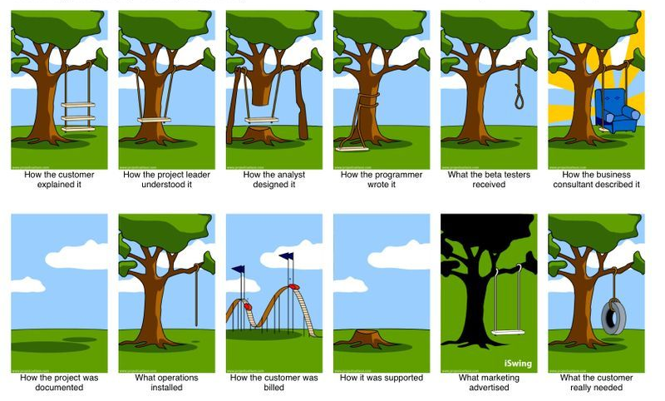

Slide 3
Test Case Development
ID
Title
Description
Pre-condition
Test Steps
Test Data
Expected Results
Actual Results
Priority
Release
Status

Slide 4
Test Environment Setup
Hardware Configurations
Operating Systems
Integrations
Test Data
Access/Permissions

Slide 5
Test Execution
Prioritize
Smoke Test
Functional Test
Non Functional Test
Test Automation

Slide 6
What is a defect?
A defect is any form of error or obstacle that comes between the software testers or users and seamless execution of the application.
This error tries to hinder the execution by mismatching the expected behavior of the software with the actual one.

Slide 7
Compulsory attributes of Software Defects
ID
Title
Description
Steps to recreate
Test Data
Test Environment
Expected results
Actual Results
Screen Shots
Severity
Priority
Status

Slide 8
Defect Status
Defect Status or Bug Status in defect life cycle is:
The present state from which the defect or a bug is currently undergoing.
The goal of defect status is to precisely convey the current state or progress of a defect or bug in order to better track and understand the actual progress of the defect life cycle.

Slide 9
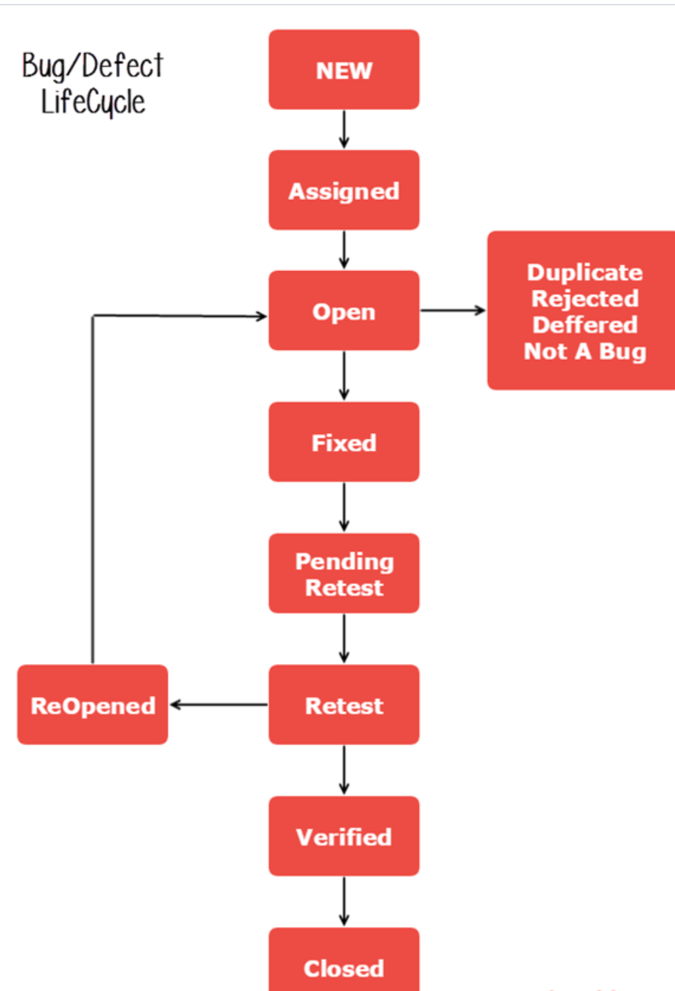

Slide 10
Make a checklist and ensure whether you have passed all the points before reporting a bug.
i. Have I reproduced the bug 2-3 times. ii. Have I verified in the Defect Tracking Tool (using keywords) whether someone else already posted the same issue. iii. Have I verified the similar issue in the related modules. iv. Have I written the detailed steps to reproduce the bug. v. Have I written proper defect summary. vi. Have I attached relevant screenshots. vii. Have I missed any necessary fields in the bug report?

Slide 11
Sample bug report
Defect ID:
Add a Defect ID using a naming convention followed by your team. The Defect ID will be generated automatically in case of defect management tool.
Reporter Name:
Name of the one who found the defect (Usually tester’s name but sometimes it might be Developer, Business Analyst, Subject Matter Expert (SME), Customer)
Defect Reported Date: Date of the defect reported
Who Detected: Add the designation of the one who found the defect. E.g. QA, Developer, Business Analyst, SME, Customer
How Detected: Testing, Review, Walkthrough
Project Name: Add name of the project. (If it’s a product, add product name)
Release/Build Version: Add the build version details here

Slide 12
Sample bug report
Defect/Enhancement: Add whether it is defect or improvement
Environment: Add Operation Systems details, Browser Details and any other related to the test environment.
(E.g. Windows 8/Chrome 48.0.2564.103)
Priority: Add the priority of the bug
(E.g. High/Medium/Low)
Severity: Add the severity of the bug
(E.g. Critical/High/Medium/Low)
Status: Add the status of the bug. If you just found and posting it then it will be New. The status of the bug will change.
(E.g. New/ Assigned/ Open/ Fixed/ Test/ Verified/ Closed/ Reopen/ Duplicate/ Deferred/ Rejected/ cannot be fixed/ Not Reproducible/ Need more information)
Description: Add a detailed description.
Steps to reproduce: Mention steps in detail. So that even the one who has no idea about the application also could reproduce the bug.

Slide 13
Sample bug report
URL: Add the URL of the application (If available)
Expected Result: Mention the expected result here which is available in your test case document.
Actual Result: Mention the actual result here which is available in your test case document.
Defect Close Date: Add the defect close date only once you ensure that the defect is not reproducible

Slide 14



Slide 15


